Slide 1
Credit
Score
Machine Learning
0577 4788 4210 0001
By Jim Rehnqvist

Slide 2
01.
OUR GOAL
Predicting Credit Scores

Slide 3

Predicting Credit Scores
Who should get a loan or credit card?
Limits of loan or credit
Risks of incorrect predictions
Won't get our money back
Lost profit

Slide 4

Predicting Credit Scores
The old way
A person looks through
It’s slow
They makes mistakes
They get tired
They takes breaks

Slide 5
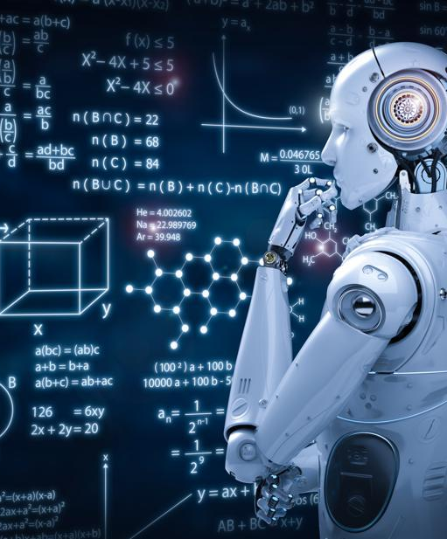
Predicting Credit Scores
The NEW way:
An AI looks through
It works 24/7
No breaks
No sleep
No complains
It's fast

Slide 6
02.
THE DATA
What do we have to work with

Slide 7
GOOD
The Data
100 000 rows × 21 columns
POOR
STANDARD
DON’T KNOW

Slide 8
HOW IT WORK
03.
MAKING A PREDICTION

Slide 9
MAKING A PREDICTION
DATA
GOOD
CLEANING
STANDARD
AI
POOR

Slide 10
CONFUSION MATRIX
GOOD
FALSE GOOD
FALSE GOOD
ACTUAL
POOR | STANDARD | GOOD
FALSE STANDARD
STANDARD
FALSE STANDARD
FALSE POOR
FALSE POOR
POOR
POOR | STANDARD | GOOD
PREDICTION

Slide 11
CONFUSION MATRIX
3010
9
1403
79 % ACCURATE
ACTUAL
POOR | STANDARD | GOOD
46
5778
1489
804
1514
10947
53 % BASELINE
GOOD | STANDARD | POOR
PREDICTION

Slide 12
04.
CHALLENGES
AND
HIGHLIGHTS

Slide 13
CHALLENGES
HIGHLIGHTS
01
Data Cleaning
04
Completed Data Cleaning
02
The Perfect Model
05
Testing My Models
03
Time
06
Standing Here
Huge DF with a lot of errors
Learned a lot
Did thousands of loops before I was happy
You can describe the topic of the section here
You never have enough time
Presenting this is probably going to be fun

Slide 14
THANKS!
359
By Jim Rehnqvist
Do you have any questions?
www.linkedin.com/in/jim-rehnqvist
https://github.com/Jay-E-Raynor
Please keep this slide for attribution

